Slide 1



Applied Data Analysis (CS401)
Lectures 10+11
Handling text data
22 Nov 2023
29 Nov 2023
Robert West
Notes:
2020: first half: 95 minutes (including a 15-min break)
2021: first half: 91 minutes (including a 15-min break); second half: 90 minutes (including an 11-min break)
2022: first half: 87 minutes (including a 14-min break); second half: 87 minutes (including a 15-min break)
2023: first half: 89 minutes (including a 13-min break); second half: 91 minutes (including a 15-min break)

Slide 2
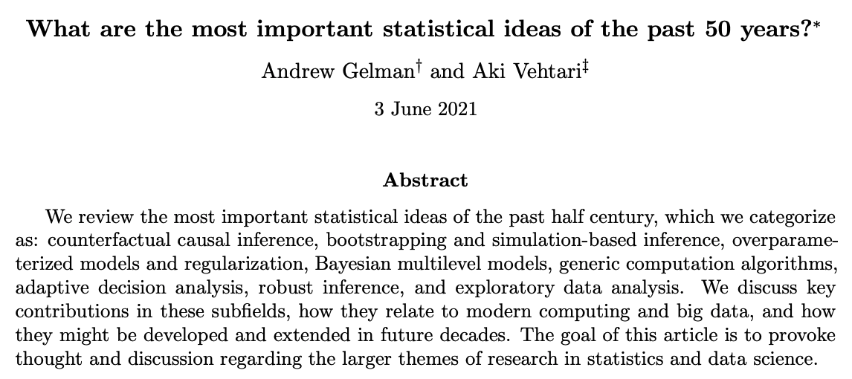
Looking back at ADA so far…
https://arxiv.org/abs/2012.00174
Notes:
5 out of 8!

Slide 3


Announcements
To all ADAmericans: Happy Thanksgiving!
Milestone P2 being graded; feedback to be released next week
Homework H2 due on Fri 1 Dec
Friday’s lab session:
Quiz 9
Homework H2 office hours (in person in BCH 2201, not on Zoom!)
Alumnus Niccolò Stefanini (ML scientist @ Expedia) will give “report from the trenches” (a.k.a. the real world of data science)

Slide 4
Give us feedback on this lecture here: https://go.epfl.ch/ada2023-lec10-feedback
What did you (not) like about this lecture?
What was (not) well explained?
On what would you like more (fewer) details?
…

Slide 5
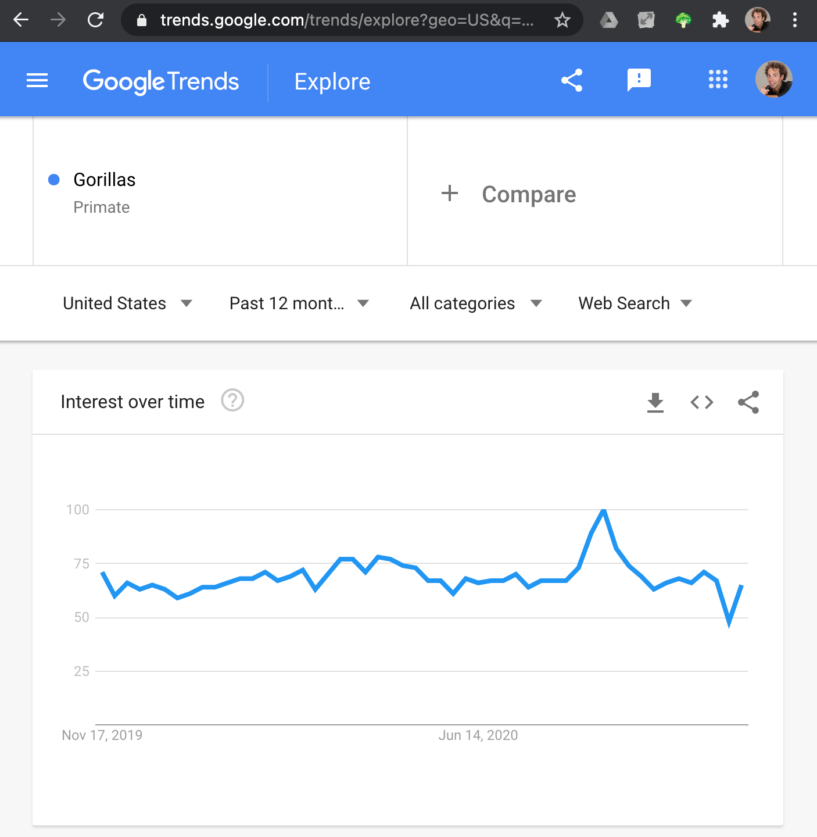
Textual data
Much modern data is unstructured text
Web
Social media
News
Several ADA project datasets…
Frequently, “clean” datasets can be derived from “dirty” textual data
e.g., search queries are short texts; Google Trends time series for concepts (e.g., Q36611 Gorilla) are obtained by aggregating all search queries referring to the concept (e.g., “gorilla”, “big black Rwandan apes”, “are gorillas humans?”)
Notes:
…
Ex.: Google Trends: crisp, clean time series capturing pop of Google search queries about a given input topic (here: Gorilla)
But search queries are really short texts, whereas what we want is pop of topics (e.g., group “gorilla” etc.)
To get these clean time series of topics (rather than verbatim queries), a lot of text processing had to happen: to aggregate, need to know which queries are about the same concept

Slide 6
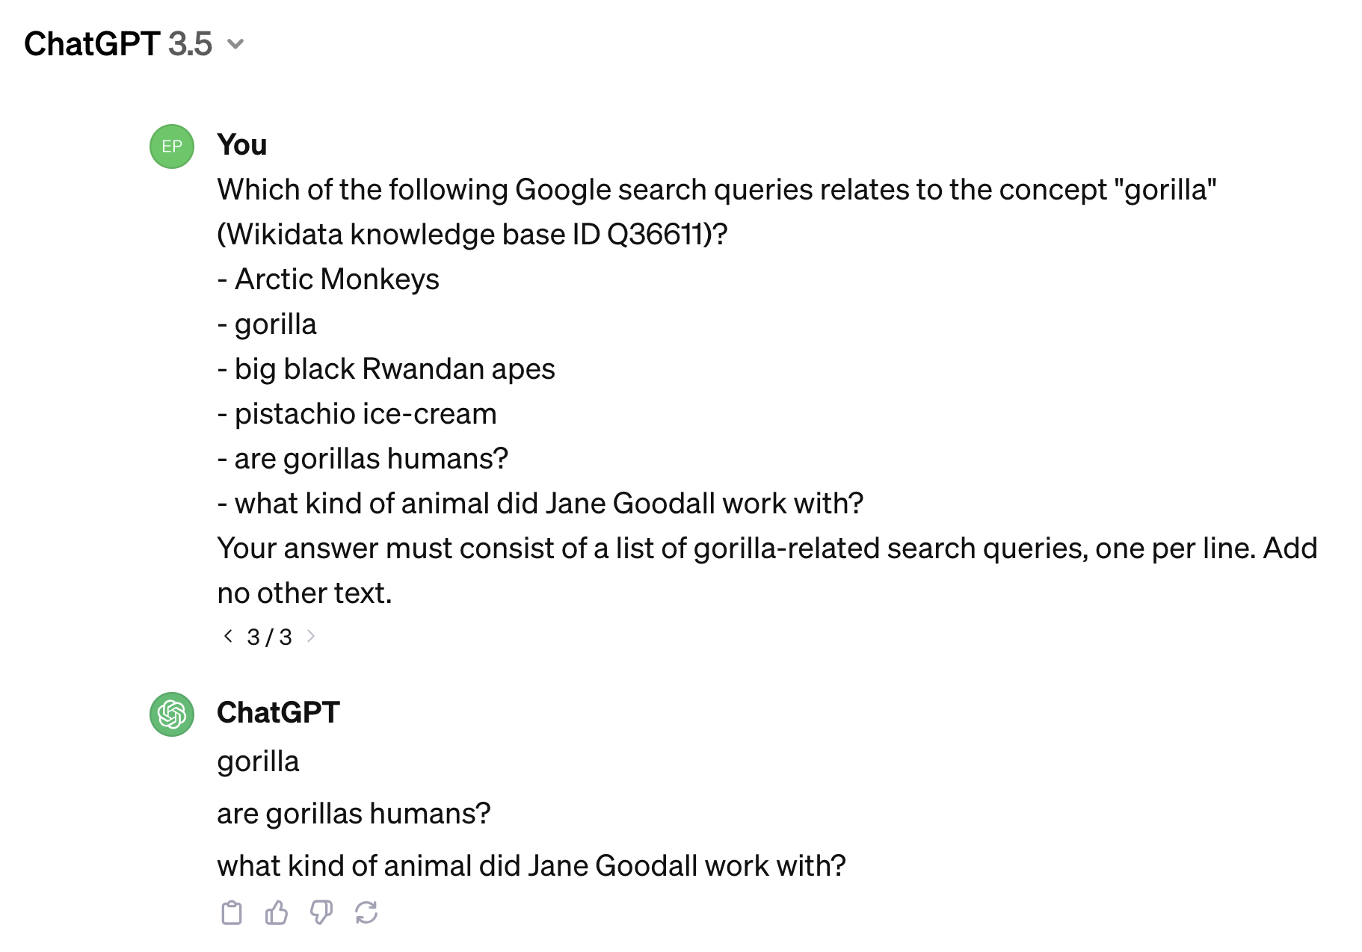
Nov 2022: the dawn of a new era
Notes:
These days, many such tasks are much easier: just ask ChatGPT to do it for you
Maybe not perfect: might also want to get “big black Rwandan apes” (but could also be chimps?)
But very good! Jane Goodall query doesn’t mention gorillas
Feel free to use ChatGPT to help you prepare your data for analysis (it may allow you to get to the interesting research questions faster). Always acknowledge it when you did!
Today’s lecture: more basic text processing techniques. Need to know those, too! (p.t.o.)

Slide 7
Outline
4 typical tasks on text data:
Document retrieval
Document classification
Sentiment analysis
Topic detection
How to phrase these tasks as machine learning problems
How to preprocess text so it can be fed to ML algorithms
Next lecture: pointers to miscellaneous more advanced topics
ADA spirit: show you what’s there; give you basic feel
For more, take classes on NLP and information retrieval

Slide 8
Typical task 1: document retrieval
Given:
Document collection (a.k.a. corpus)
Query document (can be short query string)
Task:
Rank all docs in collection by similarity to query
An old problem (e.g., libraries)
Document retrieval is the core task solved by Web search engines (“10 blue links”)

Slide 9
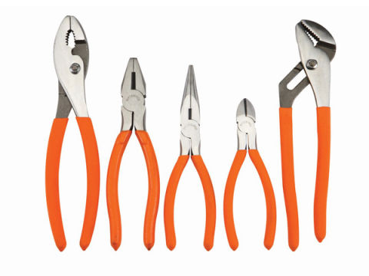

Document retrieval
Straightforward approach: neighbor search (as in kNN)
Define a distance function between documents
Given query q, find the k docs with smallest distance to q
k = 10, docs sorted by distance, blue links, ads →
The hard part: craft/learn a distance function (and scale it to the Web…)
Notes:
Which of the methods we’ve seen would you use?

Slide 10
Typical task 2: document classification
Given:
Document d
Set of classes (e.g., topics: news, sports, tech, music, romance)
Task:
Decide to which one of the classes document d belongs
Example scenario:
Find gangster movies in CMU Movie Summary Corpus
Notes:
Alternative for last point: “Find news articles about sports events in a large Web corpus”

Slide 11
Document classification
Supervised learning
Obtain a large collection of documents
Label each doc with the class it belongs to
Represent docs as feature vectors
Train a supervised classifier based on the labeled docs:
e.g., kNN, logistic regression, decision tree, random forest, boosted decision trees, neural network, …
Notes:
Which of the methods we’ve seen would you use?
kNN: don’t even really have to “train”; rather, at test time, simply compare query to all documents in the corpus

Slide 12
Typical task 3: sentiment analysis
Given:
Document d (e.g., product review)
Task:
“Sentiment” score capturing how positive/negative d is
Example scenarios:
Infer what people think about a product from text only (i.e., without explicitly given ratings)
Historical opinion analysis; e.g., how has people’s attitude toward certain politicians changed over time?

Slide 13
Sentiment analysis
Supervised learning
Regression
Classification
Same setup as for document classification:
Label a training set with ground-truth sentiment scores
Represent documents as feature vectors
Train supervised model: kNN, linear/logistic regression, …
Notes:
Which of the methods we’ve seen would you use?
kNN: don’t even really have to “train”; rather, at test time, simply compare query to all documents in the corpus

Slide 14
Typical task 4: topic detection
Given:
Unlabeled document collection
Task:
Determine a set of prevalent topics in the docs
Determine for each document to which topics it belongs
Example scenario:
Detection of trending topics in social media (e.g., Twitter)
Detection of distinct viewpoints on a political subject
Exploratory analysis of a large doc collection
Notes:
Different from doc classification:
classes/topics not known ahead of time, you need to find them
Exploratory:
Imagine I give you 10 TB of text

Slide 15
Topic detection
Clustering
Represent documents as feature vectors
Run hierarchical or point-assignment clustering algorithm
Hierarchical: agglomerative or divisive
Point-assignment: e.g., k-means, DBSCAN
Alternative: matrix factorization (cf. next lecture)
Notes:
Which of the methods we’ve seen would you use?
…
In principle, clustering algos we saw last lecture fit the bill, but in practice they struggle b/c of curse of dim → matrix fact

Slide 16


Feature vectors
Nearly all ML methods work with feature vectors
E.g., previous slides: document retrieval; document classification; sentiment analysis; topic detection
Text is not immediately a feature vector
Variable length
Even for fixed length (e.g., tweet…):
Positions don’t correspond to
meaningful features

Slide 17
Feature vectors
Need to transform arbitrarily long string to fixed-length vector
Traditional and vetted: bag of words
More recent: learn a mapping from strings to vectors (buzzword: “text embedding”)

Slide 18
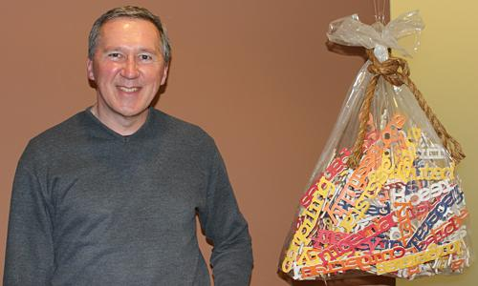
Bag of words
Bag == multiset
“multi-”: keep multiplicity of words
“-set”: don’t keep order of words
E.g., document “what you see is what you get” → bag of words {get:1, is:1, see:1, what:2, you:2}
To have fixed-length representation for all documents:
Vector with one entry for each unique word in vocabulary
Bag-of-word vectors are very high-dimensional (typically 1e5 or 1e6) and very sparse
E.g., above: [0…0 1 0…0 1 0…0 1 0…0 2 0…0 2 0…0]
Tom Mitchell (CMU)
Notes:
The protagonist of today’s lecture (not Tom, but the bag…)

Slide 19
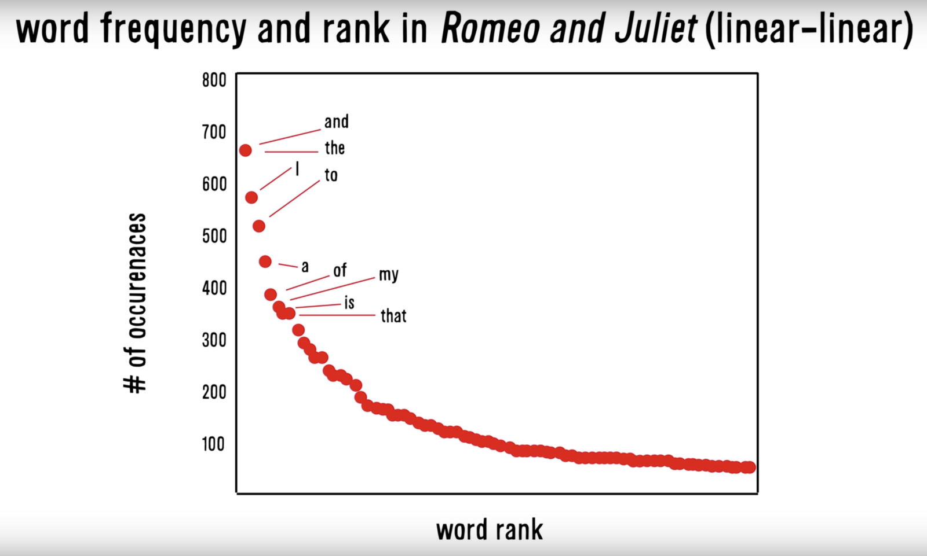


An extra reason for sparsity: Zipf’s law
A famous power law
POLLING TIME
Scan QR code or go to https://web.speakup.info/room/join/66626
On what axes would you need to draw this plot in order to make it look like a straight line?
The probability of observing a word scales inversely with its frequency rank: p(w_{i}) ∝ 1/i (where w_{i} is the i-th most frequent word)
Notes:
(1) Most docs are much shorter than the vocab size
(2) Zipf: most words are rare
→ most words aren’t contained in a given doc
So bags of words are sparse
On what axes would you need to draw this plot in order to make it look like a straight line? (A) log x, linear y (B) linear x, log y (C) log x, log y (D) sqrt x, linear y (E) linear x, sqrt y (F) sqrt x, sqrt y (G) It’s already a straight line

Slide 20
Bag-of-words matrix
docs
words
Combine document vectors as rows in a matrix
One row per doc
One column per word in vocabulary
This matrix is huge!
E.g., Wikipedia: 6M docs, 2M words → 12 trillion entries
Solution: use a sparse matrix format
Triples: (doc_idx, word_idx, count)
E.g., Wikipedia, assuming 2000 words per article on avg.: 12 billion non-zero entries (fits in memory)
With matrix representation, you’re ready to use any ML model

Slide 21
… or are you really?
In theory, yes
In practice: “garbage in, garbage out”
Be careful when mapping raw text to bag-of-words matrix!
Character encoding
Language identification
Tokenization
Stopword removal
Word normalization
Tweaking the matrix a bit can lead to much better performance
Reweight/normalize rows and/or columns of matrix

Slide 22

Bag of tricks for bags of words
Notes:
I sacrifice myself to tell you about the dirty tricks that many don’t consider worth even talking about…
These tricks give you a lot of mileage

Slide 23

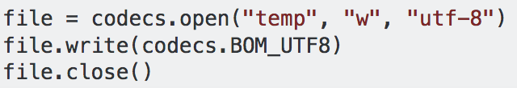
Character encoding
Mapping from (abstract) characters to bytes
Old school: ASCII, Latin-1
New school: Unicode (e.g., UTF-8, UTF-16, UTF-32)
E.g., W → 0x57 (one byte)
Reading text from file:
Need to read with encoding that was used to write file
Especially important for non-English text: à, ê, ü, ß, …
Writing to file: Always use UTF-8 or UTF-16; hard-code the output format!
Otherwise, your future self will be very angry at you (example in speaker notes 👇)
Notes:
UTF = Unicode Transformation Format
[CLICK] Spinn3r anecdote: see below
========================================
This is not entirely conclusive, but my archæological endeavors hint towards the following as a
potential history of character encoding of the Spinn3r data.
(Author: Bob West, 2014-06-06)
PHASE A (until 2010-07-13)
==========================
(1) Spinn3r's probably UTF-8-encoded data was read as Latin-1 (a.k.a. ISO-8859-1). UTF-8 has
potentially several bytes per character, while Latin-1 has always one byte per character. That is,
a single character from the original data now looks like two characters.
E.g., Unicode code point U+00E4 ("latin small letter a with diaeresis", a.k.a. "ä") is represented
by the two-byte code C3A4 in UTF-8. Reading the bytes C3A4 as Latin-1 results in the two-character
sequence "Ã¤", since C3 encodes "Ã" in Latin-1, and A4, "¤".
(2) Then, case-folding was performed on the garbled text, making it even more garbled.
E.g., "Ã¤" became "ã¤".
(3) The data was written to disk as UTF-8.
Approximate solution:
Take the debugging table from http://www.i18nqa.com/debug/utf8-debug.html, look for the garbled
and lower-cased sequences and replace them by their original character.
NB: The garbling is not bijective, but since most of the garbled sequences are highly unlikely
(e.g., "ã¤"), this should be mostly fine.
NB: Since we replace several characters ("ã¤") by a single character ("ä"), the indices of links
and quotes might be off. But I think fixing the encoding is worth more than keeping the indicices
precise.
PHASE B (2010-07-14 to 2010-07-26)
==================================
For just about 2 weeks, the data seems to have been read as UTF-8 and written as Latin-1 (i.e., the
other way round than in phase A).
Non-Latin-1 characters are printed as "?". However, there also seem to be a very few cases as in
Phase A, e.g., the second document in
/afs/cs/group/infolab/datasets/snap-private/spinn3r/spinn3r-full5/web/2010-07/web-2010-07-15T00-00-00Z.rar
Approximate solution:
Simply read the data as Latin-1.
PHASE C (2010-07-27 to 2013-04-28)
==================================
Data was written as ASCII, such that all non-ASCII characters (including Latin-1 characters),
appear as "?".
Approximate solution:
None. We simply need to byte (haha...) the bullet and deal with the question marks.
PHASE D (2013-04-29 to 2014-05-21)
==================================
Bob's version of the ProtostreamParser, i.e., capitalization and HTML markup are kept.
However, due to a bad BASH environment variable, data was written as ASCII, such that non-ASCII
characters appear as "?".
NB: We store the original content with markup, plus a markup stripped and tokenized version (tokens
are whitespace-separated). Links and quotes are extracted from the stripped and tokenized version.
PHASE E (since 2014-05-22)
==================================
Same as Phase D, but output is now written as proper unicode, by hard-coding the output encoding as
"UTF-8" in the Java code.

Slide 24
Language identification
Typically, you’re interested in text from a single language
Increasingly, content is multilingual (e.g., Twitter, Wikipedia)
Ideally, language code is specified (e.g., headers in HTML; JSON field in Twitter API results)
But not always…
There are good libraries (e.g., Python, Java)
Most commonly based on letter trigrams (e.g., “eau”, “ghi”, “ijs”, “sch”, “eiß”, “ção”)
Much harder if you messed up character encoding…
Notes:
…
Explain trigram-based approach
Guessing time!
Works nearly perfectly, except for some pathological cases (e.g., Danish/Norwegian)

Slide 25
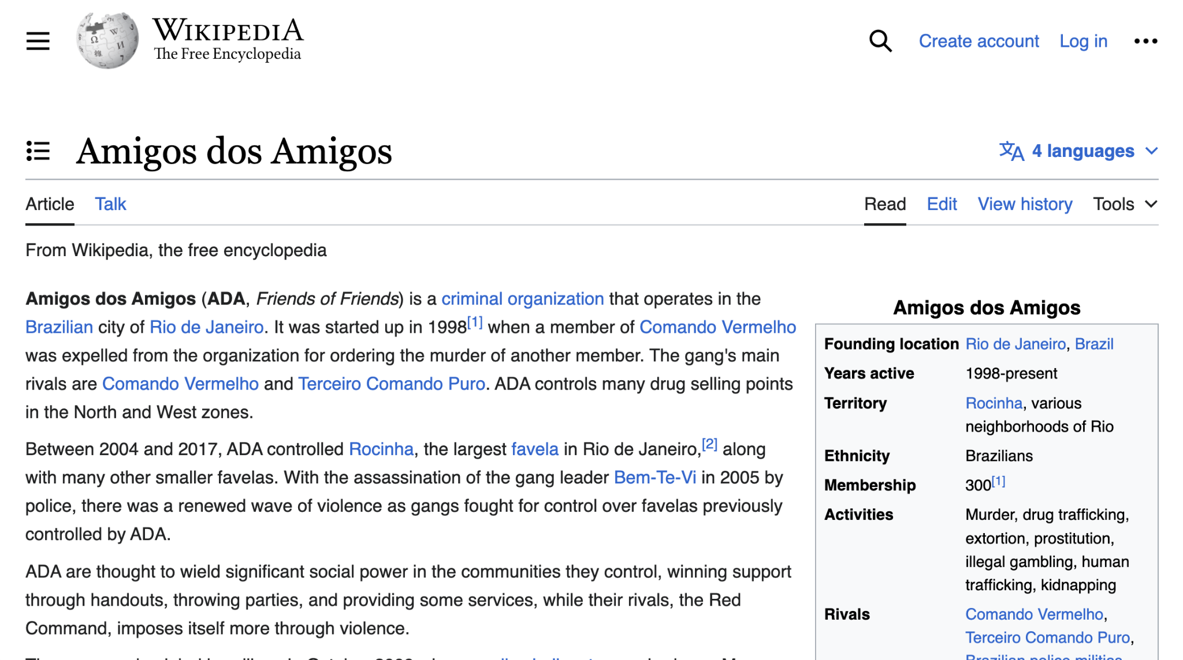
Commercial break
Looking for friends?

Slide 26
Tokenization
Maps character string into sequence of tokens (≈ words)
E.g., “Hello! How are you?” → Hello_!_How_are_you_?
Tempting to do this yourself by splitting at whitespaces and punctuation
But many corner cases:
“Hello, Mr. President! How are you?! :-)” → Hello_,_Mr._President_!_How_are_you_?!_:-)
Don’t do it yourself, use libraries instead; e.g.,
Python: spaCy, nltk; Java: Stanford CoreNLP
Rule-based, deterministic, fast
Notes:
Required in order to construct BOW matrix, which requires counting words

Slide 27
Tokenization
Optimal tokenizer different for different languages (e.g., Swedish “Sankt Peter” → “S:t Peter”), but English tokenizer often good enough
Tokenization relatively straightforward in English
Hard in, e.g., Chinese: no whitespace between words
Compound words, e.g. in German:
Advanced models can split “Donaudampfschifffahrtskapitän” into “Donau dampf schiff fahrts kapitän”
But what to keep together…? “Schiff fahrt” or “Schifffahrt”?

Slide 28
Stopword removal
Very frequent, “small” words carry little information for most tasks and can “drown out” information contained in real content words
E.g., “a”, “the”, “is”, “you”, “I”, punctuation marks
Many stopword lists online, but be careful!
Different tasks require removing different stopwords
Good heuristic: remove words appearing in at least p% of all documents (but what should p be…?)
Sometimes stopword removal hurts!
Author identification, psychological modeling; punctuation can be useful as well: e.g., “!!!”, “:-)”

Slide 29
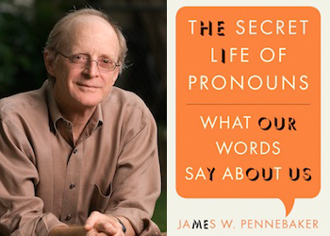
Don’t throw out the baby with the bathwater!
Notes:
Book recommendation: https://www.amazon.de/Secret-Life-Pronouns-Words-about/dp/1608194965

Slide 30
Word normalization: casefolding
E.g., “I love yams. Yams are yummy.”
Should “yams” and “Yams” really be different features?
Simple solution: make everything lower-case (“casefolding”)
But then: “I’d rather have an apple than an Apple.”
Hand-code exceptions?
In practice (especially when dataset is large), typically best to not do casefolding
But when dataset is small, might help because less sparsity
Notes:
Next, we’ll look at some feature normalization methods for text

Slide 31
Word normalization: Stemming
Map different forms of same word to same, normalized form, by stripping affixes
E.g., “walking”, “walks”, “walked” → “walk” “business”, “busy” → “busi”
Typically done in hacky, heuristic way (e.g., Porter stemmer)
Pro: decreases sparsity in bag-of-words matrix
Con: discards information
E.g., “business” vs. “busy”; “operating” (as in “operating system”)
In English (esp. with big data) typically not done anymore
Still very useful in morphologically richer languages (e.g., German, Finnish, Bantu languages)
Notes:
Link: The Finnish noun kauppa ('shop') has 2,253 forms

Slide 32
Word normalization: Lemmatization
Lemmatization == stemming++
Map tokens to lexicon entries
E.g., “U.S.A.”, “US” → “United States” “Grüße”, “Gruesse” → “Grüße” “You lie in the grass” vs. “You lie to me”
Frequently omitted, as it requires complete lexicon and complex mapping rules
Especially hard for non-English

Slide 33
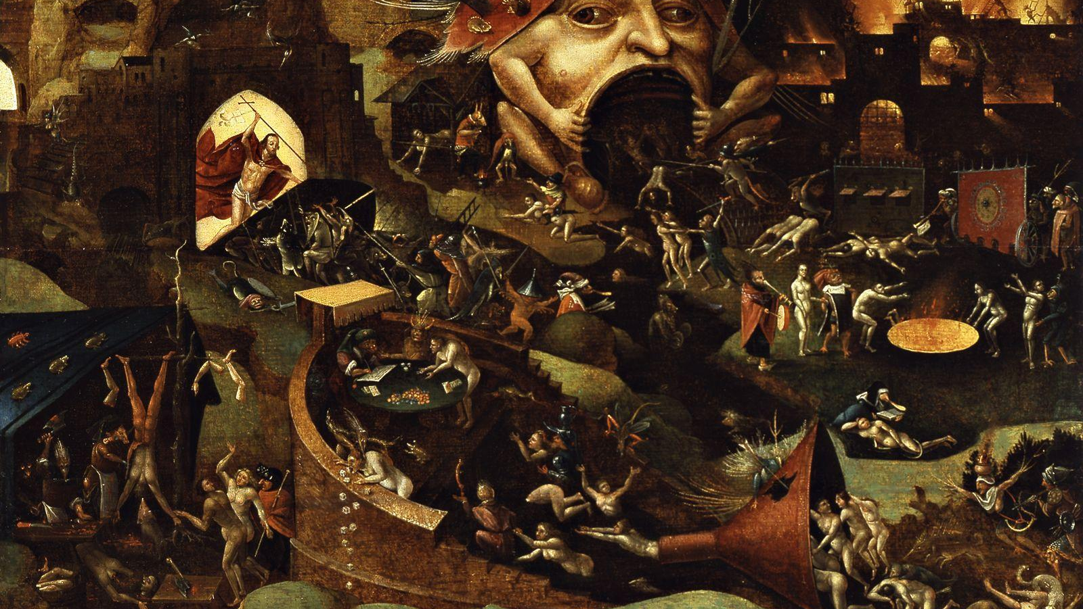
Social media
A real tweet:
“ikr smh he asked fir yo last name so he can add u on fb lololol”
Translation:
“ikr” means “I know, right?”
“smh" means “shake my head”
“fb" means “Facebook”
“yo” is being used as equivalent to “your”
“fir” is a misspelling or spelling variant of the preposition for (But who knows?!)
Also common: repeating letters/syllables (“yeahhh”, “hahahaha”, “haha”)
Good luck with traditional NLP tools…
Need dedicated toolkits such as TweetNLP
Notes:
(Background: Hieronymus Bosch painting depicting hell)

Slide 34
Tokens vs. n-grams
So far: bag-of-words matrix
Rows: documents
Columns: tokens (a.k.a. unigrams, or 1-grams)
Frequently, longer sequences belong together
E.g., “United States”, “operating system”
Brute-force approach: use n > 1
E.g., all bigrams (n = 2), all trigrams (n = 3)
Using all 5-grams can beat neural networks (Table 1 here)
Problem: combinatorial explosion
Notes:
Trigrams already rarely used

Slide 35
Tokens vs. n-grams
Smarter:
Feature selection (“multi-word expressions”, “phrase extraction”)
Simple approach for bigrams: keep bigram if mutual information between constituent tokens is large
How to generalize to n > 2?
Frequent itemset/sequence mining
Wikipedia anchor texts
Compressive feature learning (link)
Notes:
MI intuitively: if two adjacent words are much more likely to appear next to one another than we’d expect if word order was randomly shuffled

Slide 36
Postprocessing the BOW matrix
docs
words

Slide 37
Inverse document frequency
Not all words equally informative
This is the reason for removing stopwords (“a”, “the”, “is”, …)
Beyond discarding stopwords, want to give less weight to more common words
E.g., “per” vs. “perceptron”
Standard way: IDF = inverse document frequency
docfreq(w): number of documents that contain word w
N: overall number of documents
idf(w) = –log(docfreq(w) / N) = log(N) – log(docfreq(w))
Notes:
Example of log scaling (cf. lecture on applied ML)
Remember Zipf slide from earlier on! (word freq follows a power law, i.e., a heavy-tailed distr)

Slide 38
Inverse document frequency
idf(w) = –log(docfreq(w) / N)
Interpretation: information content (in terms of #bits) of event “randomly drawing a document that contains w”
Beyond this theoretical justification, IDF weighting has been shown to work well in practice
Notes:
More principled rational beyond log-scaling: info theory
Applies equally to n-grams, rather than unigrams

Slide 39
TF-IDF matrix
docs
words
tf(d, w): term frequency of word w in doc d
This is what the bag of words captures
E.g., document “what you see is what you get” → bag of words {get:1, is:1, see:1, what:2, you:2}
idf(w): inverse doc freq of w (computed on entire corpus)
TF-IDF matrix:
Entry in row d and column w has value tf(d, w) * idf(w)
Amounts to multiplying column w with constant idf(w)

Slide 40
Row normalization of TF-IDF matrix
Longer docs have more non-zero entries
Interpreted as vectors, longer docs have longer vectors
This may throw off ML algorithms
Long vectors far away from short vectors
Dot product: random vector has higher dot product with longer vector
Fix: normalize doc vectors, i.e., rows of TF-IDF matrix
L2-normalization: all rows have Euclidean distance 1 from origin (all data points lie on a unit sphere)
L1-normalization: all rows sum to 1, i.e., can be interpreted as distribution
How to know which one is better?
Notes:
Cross-validation!

Slide 41
Column normalization
IDF-scaling may be seen as column normalization
Additionally, it may help to apply any of the normalization techniques we discussed in lecture 8 (“Applied ML”)
Min-max scale
Standardize: subtract mean; divide by standard deviation
How to know which one (if any) to use?
Notes:
Should you do row or column normalization first? Depends!

Slide 42
Bag of tricks for bags of words
Stay tuned!
Next week: Part 2

Slide 43
Applied Data Analysis (CS401)
Lectures 10+11
Handling text data
22 Nov 2023
29 Nov 2023
Robert West

Slide 44
Announcements
Homework H2 due this Fri 1 Dec 23:59
Reminder: We won’t answer questions asked during final 24h
Projects:
Milestone P2 grades have been released
Start working on Milestone P3 after Friday!
Friday’s lab session:
Exercises on handling text

Slide 45

Recap
Let me open my bag of tricks for bags of words for you! But only if you were good children...
Reminder: bag-of-words matrix
docs
words
Notes:
Last lecture:
4 typical tasks on text data
How to phrase these tasks as machine learning problems
How to preprocess text so it can be fed to ML algorithms
Result of that preprocessing: the BOW matrix (one row per doc, one col per word)
I sold you all of this as a “bag of tricks for bags of words”

Slide 46
Revisiting the 4 typical tasks
Document retrieval
Document classification
Sentiment analysis
Topic detection
TF-IDF matrix to the rescue
Entry for doc d, word w: tf(d, w) * idf(w)
docs
words
Notes:
Today: revisit the 4 typical tasks in more detail, in the light of the TF-IDF matrix representation on which we’ve spent so much time last week
…
TF-IDF matrix: one row vector per doc
When making a doc vector: more weight for a word if it appears a lot in the doc; less weight if it also appears a lot everywhere else

Slide 47
Typical task 1: document retrieval
Nearest-neighbor method in spirit of kNN
Compare query doc q to all documents in the collection (i.e., rows of the TF-IDF matrix)
Rank docs from collection in increasing order of distance
Distance metrics
Typically cosine distance (= 1 – cosine similarity)
Recall: cosine similarity of q and v = <q/|q|, v/|v|>
If rows are L2-normalized, may simply take dot products <q, v>
docs
words
Notes:
…
Q: advantages of cosine vs., say, Euclidean distance? cosine implicitly accounts for varying doc length
Useful fact (can prove on a napkin): after normalizing x, y to unit L2-norm, cos_dist(x, y) = 0.5 * ||x-y||^2

Slide 48
Typical task 1: document retrieval
This is just the most basic approach
For efficiency
Start by filtering documents by presence of query terms (use efficient full-text index)
Hugely narrows down set of documents to be ranked
Google et al. do much more…
Query-independent relevance: PageRank
Boost recent results
Personalization, contextualization
…
Notes:
But cutting-edge search engines don’t strictly filter by words: can match a doc that doesn’t contain query term… (use deep learning to represent docs in a semantic space)

Slide 49
Typical task 2: document classification
Use TF-IDF matrix as feature matrix for supervised methods (cf. lecture 7)
Often more features (words) than documents
What’s the danger with this?
docs
words
High model capacity can lead to overfitting (high variance)
Potential solutions:
Use more data (i.e., more labeled training docs)
Decrease model capacity:
Feature selection
Regularization (two slides from now)
Dimensionality reduction (a few slides from now)
Use ensemble methods such as random forests
Notes:
Lin alg view: underdetermined linear system; can fit training data perfectly
(explain overfitting with example: single word that perfectly marks class in training data; more in 2 slides)
==========
5-grams beat NNs only when carefully regularized

Slide 50
Typical task 3: sentiment analysis
When treated as classification: Ctrl-C Ctrl-V previous slide
When treated as regression: Pretty much the same (most supervised methods work for both classification and regression)
docs
words

Slide 51
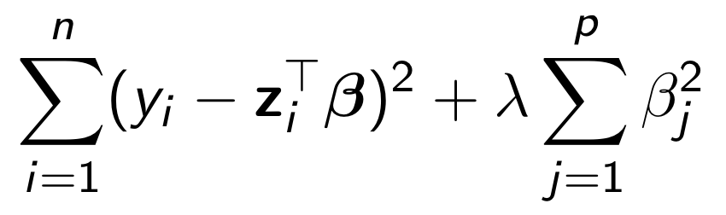
Regularization
E.g., linear regression: Find weight vector β that minimizes (x_{i}: feature vector of i-th data point; y_{i}: label of i-th data point, e.g., sentiment [1–5 stars] expressed in document i)
If one word j appears only in docs with sentiment 5, we can obtain very small training error on these docs by making β_{j} large enough
But doesn’t generalize to unseen test data!
Remedy: penalize very large positive and very large negative weights:
x
minimize
x
Notes:
Let’s get back to the problems that may arise when you have more unique words than documents in your corpus
And let’s look at one solution to those problems: regularization
…
I used lin reg as an example b/c it’s the method we’ve maybe seen most in ADA
But argument maybe even clearer when thinking of logistic regression: training loss better the larger we make \beta_j → will try to make it infinity

Slide 52
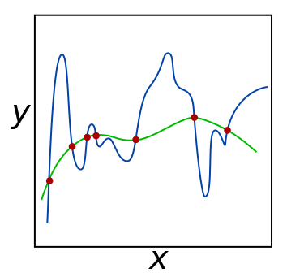
Regularization
Which curve resulted from adding a regularization term to the loss function?
POLLING TIME
Scan QR code or go to https://web.speakup.info/room/join/66626
Notes:
Another view: break ties between multiple solutions if problem is underconstrained
Both models (blue and green) fit data (red) perfectly
One of them is regularized (biased toward smaller weights) → generalizes better to unseen data
Poll: which one was regularized?
Which curve resulted from adding a regularization term to the loss function?
(A) The green curve (B) The blue curve
(C) None, since they both fit the red points perfectly
(D) Impossible to tell from the info contained in the plot

Slide 53
Typical task 4: topic detection
Cluster rows of TF-IDF matrix (each row a data point)
Manually inspect clusters and label them with descriptive names (e.g., “news”, “sports”, “romance”, “tech”, “politics”)
In principle, may use k-means, k-medoids, etc.
But can be difficult if dimensionality is large (#words ≫ #docs)
“Curse of dimensionality”
Many outliers
docs
words
Notes:
“Manually inspect”: can look at centroid/clustroid, or at original docs

Slide 54
Typical task 4: topic detection
Alternative approach: matrix factorization
Assume docs and words have representation in (latent) “topic space”
(IDF-weighted) word frequency modeled as dot product of doc’s vectors and word’s vectors in topic space
#topics ≪ #words (→ “dimensionality reduction”): D*W → (D+W)*T
Topics interpretable in doc space (A’s cols) and word space (B’s rows)
words
“topics”
words
TF-IDF
A
B
“topics”
docs
≈
docs
Notes:
Dot product: similar topic vectors → high TF-IDF score

Slide 55
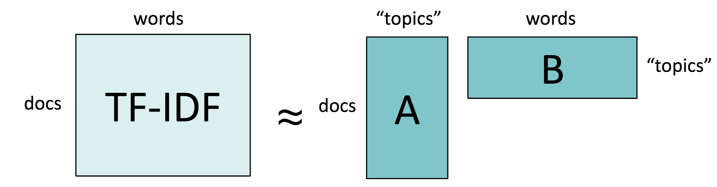
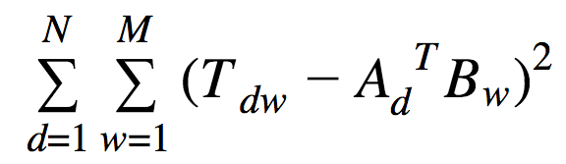
Typical task 4: topic detection
Optimization problem:
Find A, B such that AB is as close to TF-IDF matrix as possible
That is, minimize where T is TF-IDF matrix, A_{d} is d-th row of A, and B_{w} is w-th column of B
This is called latent semantic analysis (LSA)

Slide 56
Typical task 4: topic detection
You already know how to efficiently
compute this, from your linear algebra
class: singular-value decomposition (SVD)
T = USV^{T}
Freebie: columns of U and V are orthonormal bases (yay!)
S is diagonal (with values in decreasing order) and captures “importance” of topic (amount of variation in corpus w.r.t. topic)
If you want k topics, keep only the first k columns of U and V, and the first k rows and columns of S → U’, S’, V’
E.g., A = U’, B = S’V’^{T} or A = U’S’, B = V’^{T}
Notes:
Orthogonality: topic vectors (in terms of docs and words, respectively) are uncorrelated (i.e., they roughly capture non-redundant signals)

Slide 57
Typical task 4: topic detection
Recall potential problem with clustering and classification and regression: “curse of dimensionality”
Matrix factorization via LSA solves these problems for you:
Use A instead of original TF-IDF matrix
That is, cluster (or learn to classify or regress) in topic space, rather than word space
Topic representation from LSA is simply a vector, not a probability distribution over topics
Probabilistic: LDA = Latent Dirichlet Allocation (p.t.o.)

Slide 58
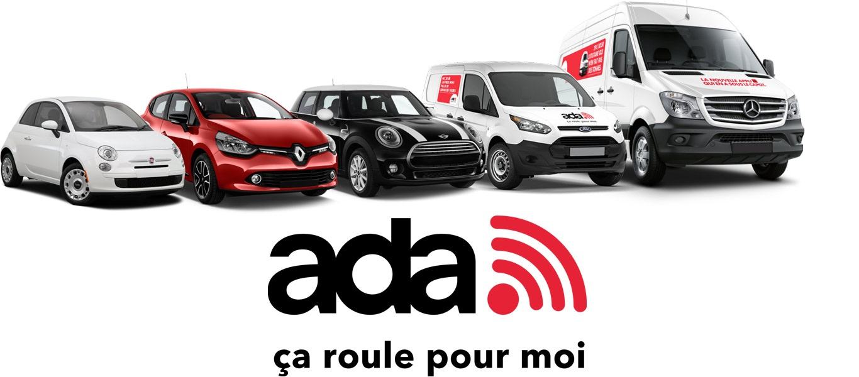
Commercial break

Slide 59
LDA: probabilistic topic modeling
Latent Dirichlet Allocation (not Latent Discriminant Analysis!)
Document := bag of words
Topic := probability distribution over words
Each document has a (latent) distribution over topics
“Generative story” for generating a doc of length n: d := sample a topic distribution for the doc (← “Dirichlet”) for i = 1, …, n t := sample a topic from topic distribution d w := sample a word from topic t Add w to the bag of words of the doc to be generated
Notes:
Generative story not how documents are really generated → just a model!
Idea: assuming this model is true, what set of topics and topic proportion of docs is most likely to have generated observed bag of words?
Dirichlet distribution: distribution over multinomial distributions
How to learn topics of corpus, and topic proportion of docs?
After next slide
First: visual example

Slide 60
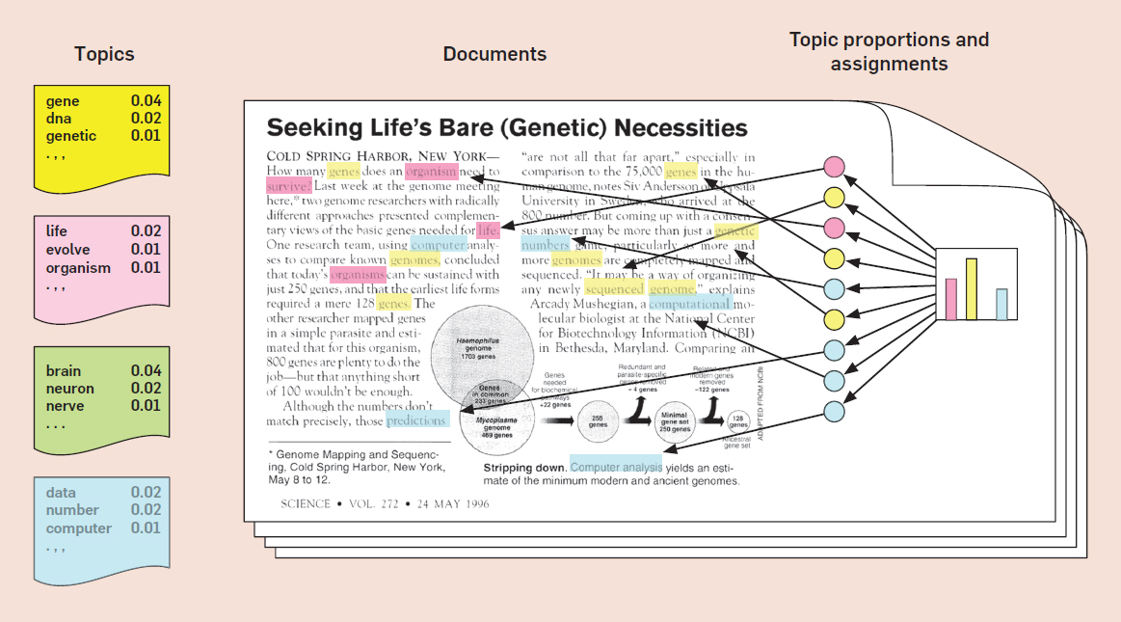
Notes:
LDA does not model the order of words (docs are considered bags of words)
…
LDA observes the actual docs (BOWs) and “reverse-engineers” the topics (left) and each doc’s distribution over topics (right)

Slide 61
Topic inference in LDA
LDA is unsupervised (topics come out “magically”)
Input:
Docs represented as bags of words
Number K of topics
Output:
K topics (distributions over words)
For each doc: distribution over K topics
How is this done?
Find distributions (i.e., topics, docs) that maximize the likelihood of the observed documents (maximum likelihood)

Slide 62
Question:
“Which of these word pairs is more closely related?”
(car, bus)
(car, astronaut)
How to quantify this?
Detour:
How to quantify closeness of two docs?
E.g., cosine of rows of TF-IDF matrix
words
TF-IDF
docs
Retour:
How to quantify closeness of two words?
E.g., cosine of cols of TF-IDF matrix
Notes:
“Duality” of words and docs

Slide 63
Sparsity in TF-IDF matrix
Two docs (i.e., rows of TF-IDF matrix)
“Do you love men?”
“Adorest thou the likes of Adam?”
Cosine of row vectors of TF-IDF matrix == 0
Same problem when comparing two words (i.e., cols of matrix)
Solution:
Move from sparse to dense vectors
But how?
Latent semantic analysis (LSA)!
Use columns of B as dense vectors representing words
Notes:
Similar with two words (instead of two docs): might not co-occur in any docs
Can also use LDA instead of LSA

Slide 64
“Word vectors”
Columns of TF-IDF matrix (sparse) or of word-by-topic matrix B (dense)
Problem:
Entire doc treated as one bag of words
All information about word proximity, syntax, etc., is lost
Solution:
Instead of full docs, consider local contexts: windows of L (e.g., 3) consecutive words to left and right of the target word
Rows of matrix: not docs, but contexts
words
M
contexts
Notes:
This brings us to the topic of word vectors. Instead of using the columns of T or B from LSA, there are many other ways of def’ing vector reps for words
Ex.: left and right | of | the target word:
Context: “left and right | the target word”
…
Same context may appear multiple times, possibly across many docs
What to use as entries of M? → p.t.o.

Slide 65
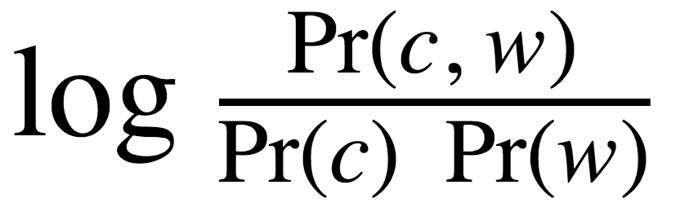
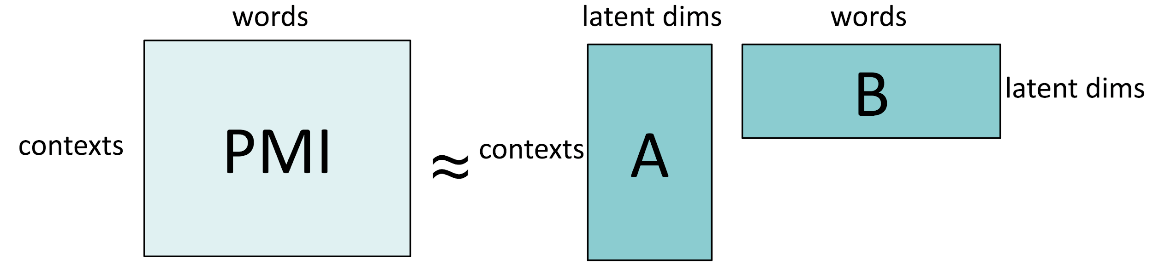
“Word vectors”
words
M
contexts
What to use as entries of word/context matrix?
Straightforward: same as TF-IDF, but with contexts as “pseudo-docs”: M[c,w] = TF-IDF(c,w)
May use any other measures of statistical association
E.g., pointwise mutual information (PMI): M[c,w] = PMI(c,w) = “How much more likely are c and w to occur together than if they were independent?”
word2vec: factor PMI matrix and use columns of B as word vectors
Notes:
Pseudo-docs: for each context, make a “fake doc” where you concatenate all central target words that appear in that context
PMI example: “component”, “principal | analysis”
Not the usual way of introducing word2vec…
Authors of w2v weren’t aware of this: Israeli researchers found out years later

Slide 66
Beyond bags of words

Slide 67
From words to texts
Word vectors represent, well, words
How to represent larger units, such as sentences, paragraphs, docs?
Typical approach: take sum/average of word vectors
Note: this is roughly also what bags of words are (when using “one-hot” encoding for words, i.e., vector with exactly one 1, rest 0)
More recently: learn vectors for longer units
Cr5, sent2vec
Convolutional neural networks
Recurrent neural networks, e.g., LSTM, ELMo
Transformer-based models, e.g., BERT (next slides), GPT-*
Notes:
Q: which row normalization does taking avg. over words correspond to?

Slide 68
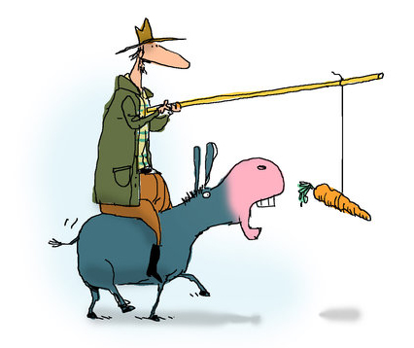
Contextualized word vectors
Motivating example:
“My ass likes carrots”
vs. “He’s such an ass”
Classic word vectors (e.g., word2vec) cannot distinguish these two cases; same vector used for both instances of “ass”
Solution: contextualized word vectors
E.g., BERT

Slide 69

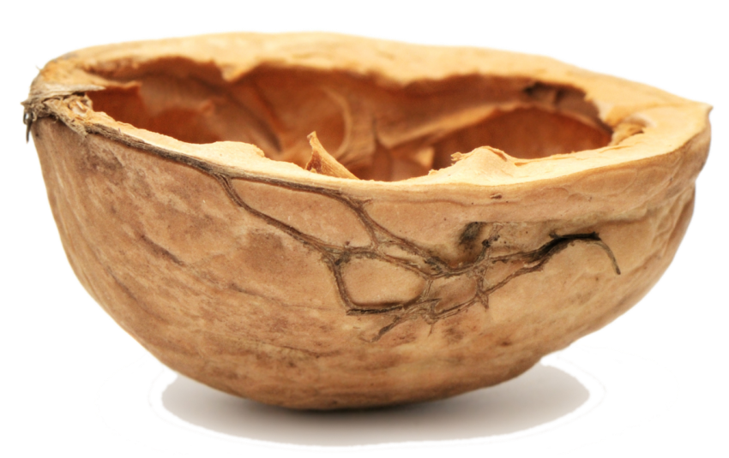
BERT in a nutshell
Introduced in 2018 by Google Research
<START>
my
ass
likes
carrots
[1.00,0.70,0.90,0.50,0.06,…]
[0.54,0.75,0.56,0.45,0.09,…]
[0.44,0.76,0.77,0.31,0.82,…]
[0.91,0.62,0.53,0.75,0.74,…]
[0.92,0.37,0.25,0.49,0.24,…]
doc vector
context- ualized word vectors
<START>
he
’s
such
an
ass
[0.85,0.62,0.71,0.11,0.58,…]
[0.49,0.25,0.22,0.36,0.75,…]
[0.61,0.87,0.73,0.96,0.52,…]
[0.58,0.02,0.01,0.92,0.76,…]
[0.35,0.72,0.64,0.26,0.49,…]
[0.53,0.42,0.64,0.26,0.01,…]
Inside the black box: some nasty neural network
Notes:
Vectors for “ass” different in 1st vs. 2nd doc! (hence “contextualized”)
=====
2021: over 30,000 citations (1y ago: 12,500; 2y ago 2,600 citations) → 17,500 citations in one year (48 per day)

Slide 70
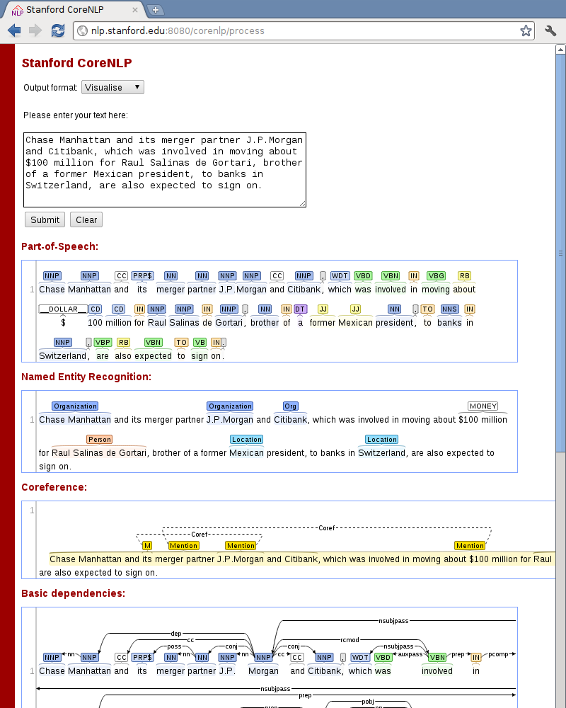
NLP pipeline
Tokenization
Sentence splitting
Part-of-speech (POS) tagging
Named-entity recognition (NER)
Coreference resolution
Parsing
Shallow parsing (a.k.a. chunking)
Constituency parsing
Dependency parsing

Slide 71
NLP pipeline
Implemented by Stanford CoreNLP, nltk, spaCy, etc.
Sequential model
Fixed order of steps
Early errors will propagate downstream
Fixed order not optimal for all cases (e.g., syntax usually done before semantics, but semantics might be useful for inferring syntax)
Hence, current research: learn all tasks jointly (early example)
To learn how all this magic is implemented
Take CS-431 (Intro to NLP), CS-552 (Modern NLP)

Slide 72
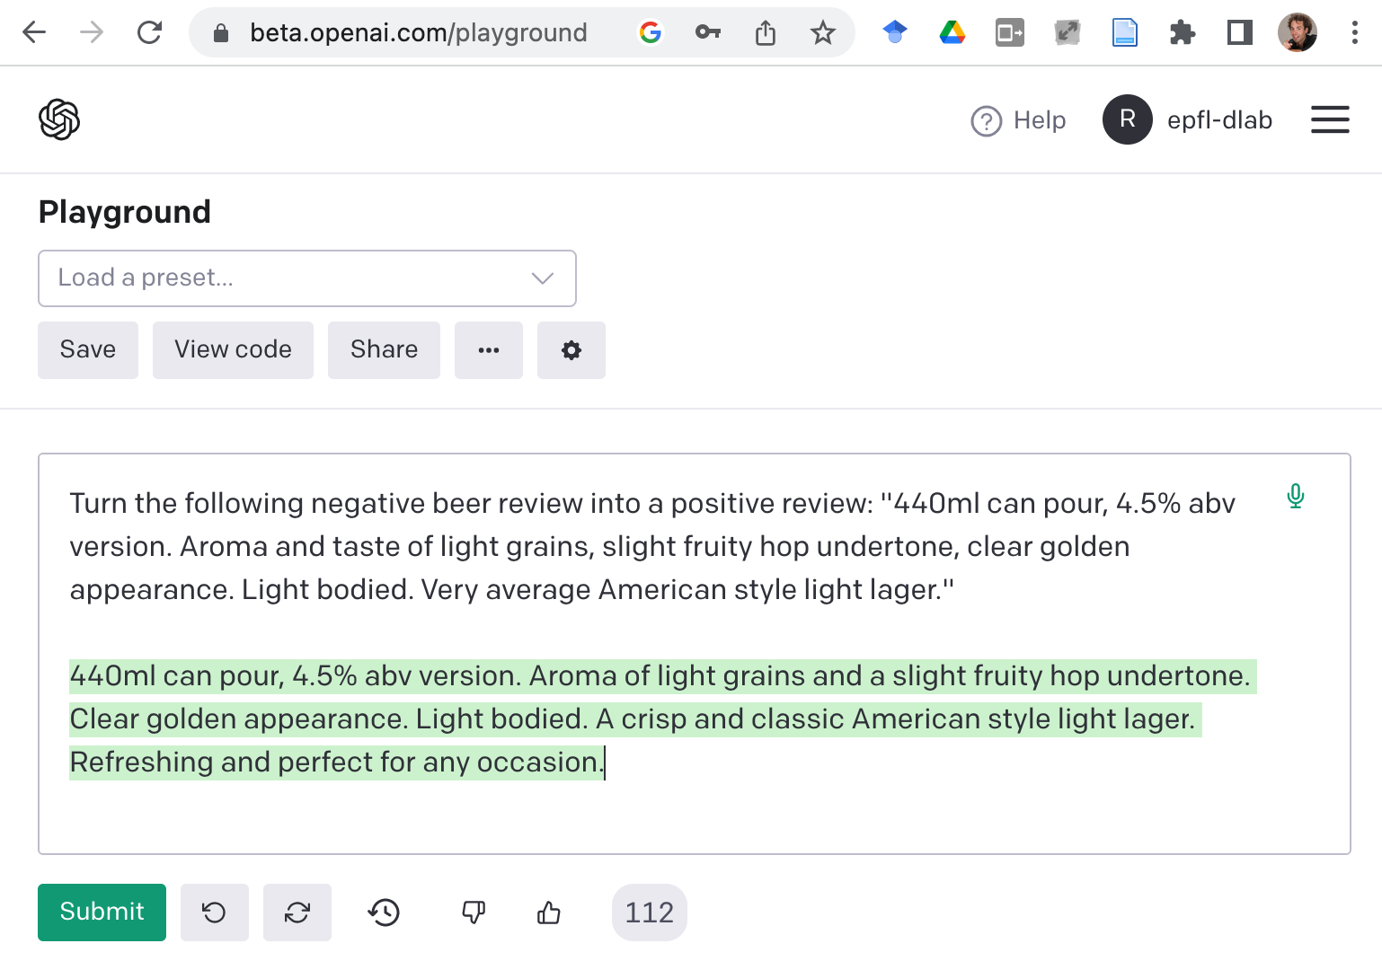
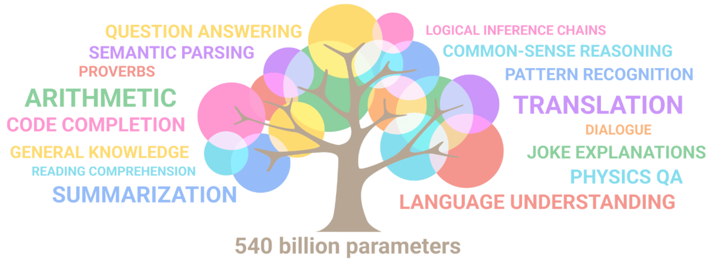
Today’s trend: generative language models
E.g., OpenAI GPT-*, ChatGPT
Input: text
Output: text
Many NLP tasks can be formulated in this framework, by “prompting” the language model with the right input
Notes:
“Who has heard of GPT-3?” – when asking this Q one year ago, only a small number of students raised their hands
Review is for Budweiser: https://www.ratebeer.com/beer/budweiser/473/

Slide 73
Give us feedback on this lecture here: https://go.epfl.ch/ada2023-lec10-feedback
What did you (not) like about this lecture?
What was (not) well explained?
On what would you like more (fewer) details?
…

